Slide 1
QUADRATIC EQUATIONS

Slide 2
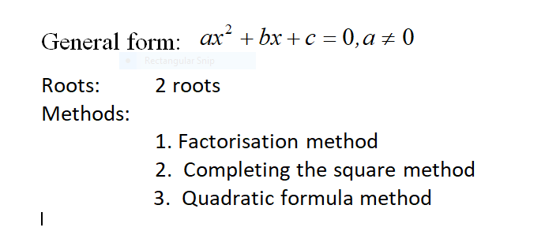

Slide 3
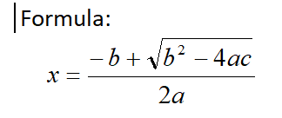
3 /3

